Slide 1
Navigating Shifts in SLP Practice
SHAV Annual Conference 2024

Slide 2
Donna Bryant
Financial Disclosure:
Receives a salary from Spotsylvania County Schools where employed full-time as Related Service Coordinator.
Discounted conference rate from SHAV for being a presenter
Nonfinancial Disclosures:
Current Past President of SHAV

Slide 3
Catherine Thompson
Financial Disclosures:
Receive a salary from Arlington Public Schools, where I am employed full-time as the Lead Speech-Language Pathologist and Student Support Coordinator
Discounted conference rate from SHAV for being a presenter
Non-financial Disclosures:
Member of the American Speech-Language Hearing Association (ASHA) and Speech Hearing Association of Virginia (SHAV)

Slide 4
Agenda
Introductions and overview of agenda
Overview of Shifts in SLP practice
Factors influencing the shifts in telepractice provision
Impact and management of the shifts related to telepractice
Factors influencing the use of SLPAs in practice
Impact and management of the shifts related to SLPA support
Factors influencing the shifts in communication needs
Impact and management of the shifts related to communication needs due to pandemic
Wrap up; Questions and Answers

Slide 5
Learner Outcomes
Participants will be able to
Identify three recent shifts in SLP practice
Describe 3 factors influencing these shifts
Describe 3 strategies to manage the impact of these shifts on SLP practice to create positive outcomes for clients

Slide 6
“Change is the only constant in life. One’s ability to adapt to those changes will determine your success in life.”
Benjamin Franklin
“If you want to change the future, you must change what you’re doing in the present. “
Mark Twain
“It doesn’t matter how strong your opinions are. If you don’t use your power for positive change you are indeed part of the problem.”
Coretta Scott King
“Change is hard because people overestimate the value of what they have and underestimate the value of what they may gain by giving that up. “
James Belasco & Ralph Stayer
“Change is inevitable. Growth is optional.”
John C. Maxwell

Slide 7
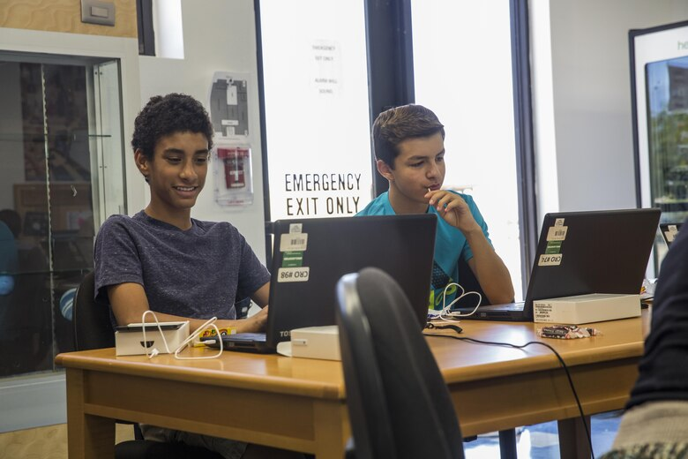
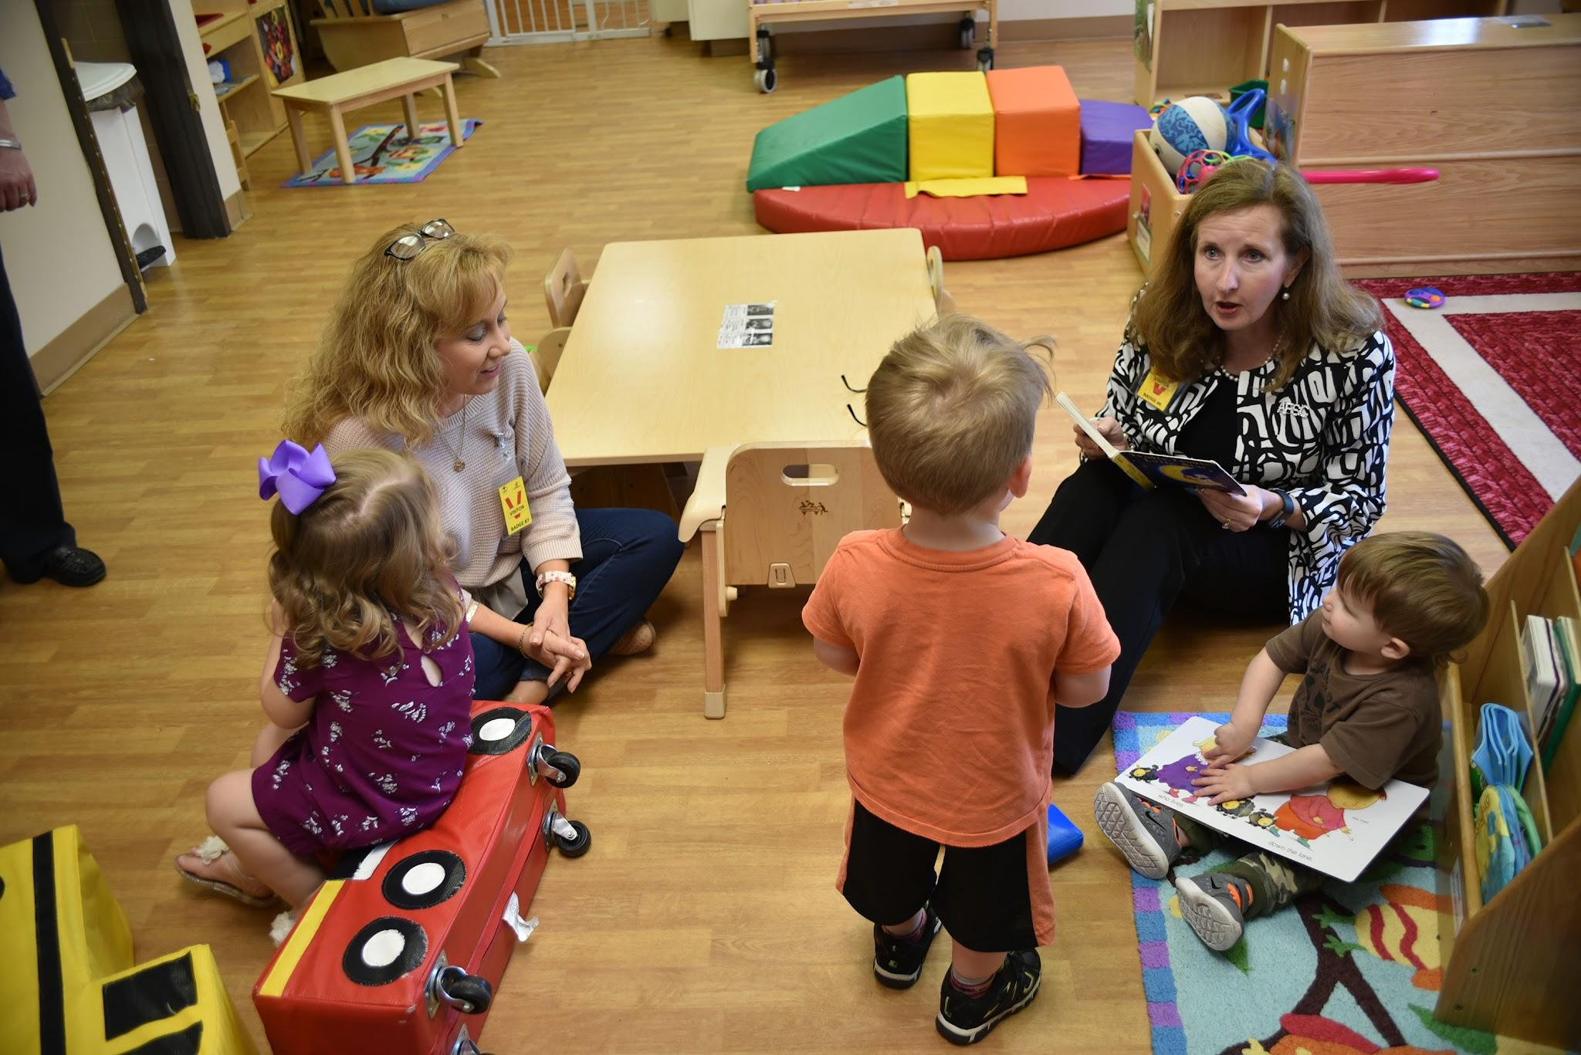
Shifts in SLP Practice

Slide 8
Navigating the Shifts
Consider Possibilities | Know | Then
Influence Impact | Research Goal | Accept Adapt Manage Assess

Slide 9
Telepractice

Slide 10
Telepractice - Influencing Factors
Improved:
Technology
Provider skills
Client access
Acceptance
Changed:
Need
Virtual Services
Open Positions
Laws
Regulations
Perspectives

Slide 11
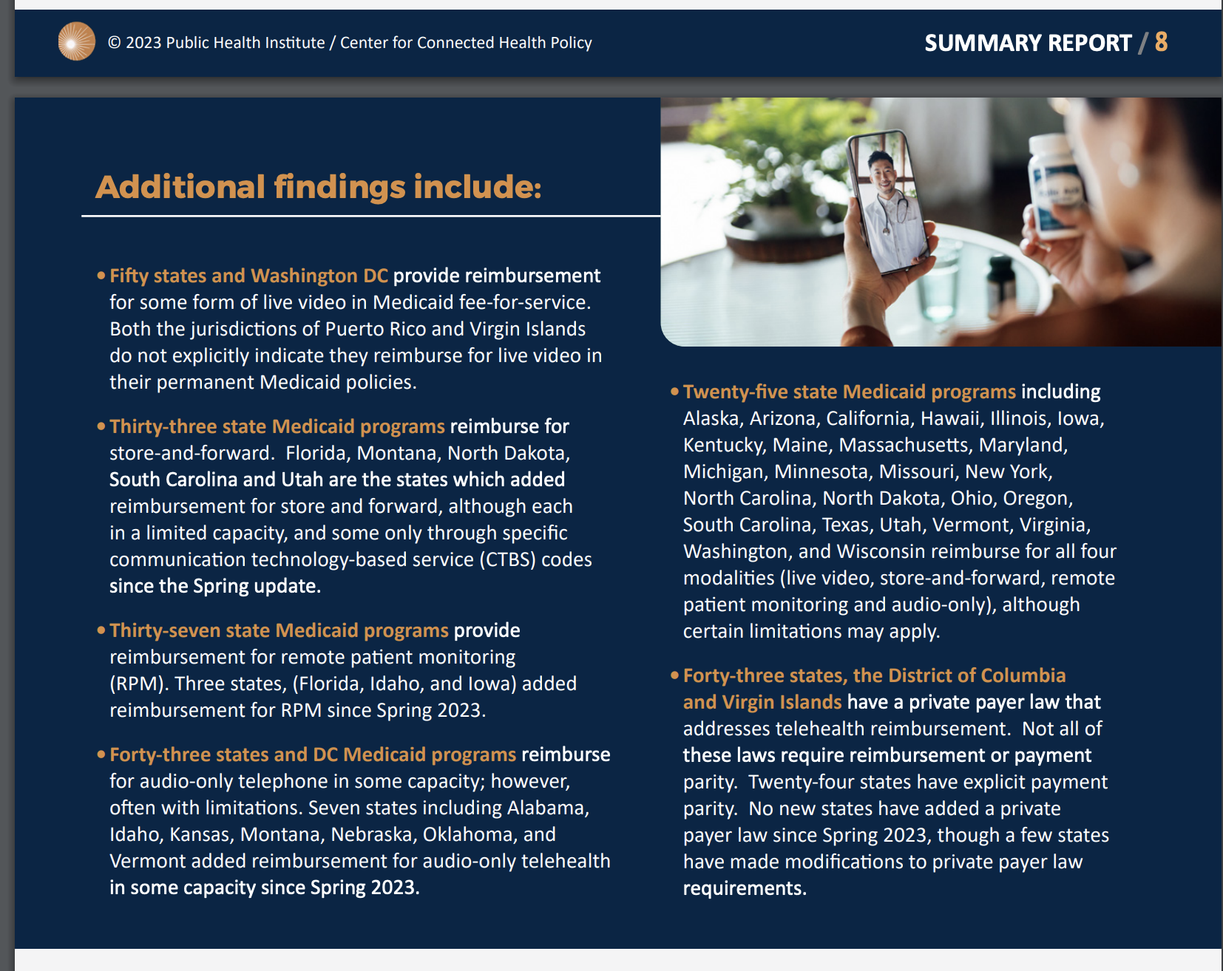

Slide 13
Telepractice - Research & Goal
Effective services:
Coufal K., Parham D., Jakubowitz M. , Howell C., Reyes J. (2018). Comparing traditional service delivery and telepractice for speech sound production using a functional outcome measure. AJSLP (27) 82-90. | Found comparable change scores in NOMS data for treatment outcomes for in-person and telepractice.
Douglas S.N., Biggs E.E., Meadan H. , Bagawan A. (2021). The effects of telepractice to support family members in modeling a speech-generating device in the home. AJSLP (30), 1157-1169. | Targeted coaching via telepractice for training and use of AAC with a child with complex needs. It increased the rate of modeling using the memory aid Prepare, Show, Wait, Respond.
Quinn E.D., Kaiser A.P., Ledford J. (2021). Hybrid telepractice delivery of enhanced milieu teaching: effects on caregiver implementation and child communication. JSLHR (64) 3074-3099 | With intervention there was accurate use of strategies and frequent strategy use that continued post intervention. Coaching followed a Teach-Model-Coach-Review format.
Schmitt, M. B., Tambyraja, S., Thibodeaux, M., & Filipkowski, J. (2022). Feasibility of assessing expressive and receptive vocabulary via telepractice for early elementary-age children with language impairment. Language, Speech, and Hearing Services in Schools. https://doi.org/10.1044/2021_lshss-21-00057 | SLPs can conduct telepractice assessments with common technology reliably.

Slide 14
Telepractice - Research & Goal
And more…
Arnold, H. L., Plante, E., & Vance, R. (2022). Translating enhanced conversational recast to a telepractice setting. Language, Speech, and Hearing Services in Schools. https://doi.org/10.1044/2021_lshss-21-00051 | 6/7 students made meaningful gains in treatment and retained gains. Results were comparable to face to face.
Henry, A. R., Conner, C., Zajic, M. C., & Solari, E. J. (2022). Feasibility and initial efficacy of an adapted telepractice listening comprehension intervention for school-aged children with autism. Journal of Autism and Developmental Disorders. https://doi.org/10.1007/s10803-022-05474-6 | The intervention was feasible with some effect on listening comprehension over the month of treatment.
Lund, E. & Werfel, K. L. (2022). The effects of virtual assessment on capturing skill growth in children with hearing loss. Language, Speech, and Hearing Services in Schools. https://doi.org/10.1044/2021_lshss-21-00074 | This early data supported the use of virtual assessment with this population.
Magimairaj, B. M., Capin, P., Gillam, S.L., Vaughn, S., Roberts, G, Fall, A., Gillam, R. (2022). Online administration of the Test of Narrative Language-Second Edition: Psychometrics and considerations for remote assessment. LSHSS, https://doi.org/10.1044/2021_LSHSS-21-00129 | Results showed psychometrics were not significantly different from in- person results. Test results were valid and reliable.

Slide 15
Telepractice - Adapt & Manage
Then:
Provide training
Establish procedures
Have written referents
Support providers
Create mixed teams
Regular check-ins
Availability
Support stakeholders
Check-in
Answer questions
First:
Determine need
How many providers
Skill set needed
Clients to serve
Hire qualified providers
Put supports in place
In-person facilitator
Technology
Space
Communication to stakeholders

Slide 16
SLPAs

Slide 17
SLPAs - Influencing Factors
Changed:
ASHA establishes pathways for SLPA certification.
States establish regulations, registration, licensure, or guidance for SLPAs in practice.
SLP shortages
Increases in caseloads
SLPAs

Slide 18
SLPAs - Research
“Individual or group sessions: How much does service delivery type matter?” (Informed SLP)
A study in 2009 provided evidence that sessions provided by SLPAs can yield similar results to individual sessions provided by SLPs
Boyle, J.M., McCartney, E., O'Hare, A. and Forbes, J. (2009), Direct versus indirect and individual versus group modes of language therapy for children with primary language impairment: principal outcomes from a randomized controlled trial and economic evaluation. International Journal of Language & Communication Disorders, 44: 826-846. https://doi.org/10.1080/13682820802371848
Notes:
Informed SLP did a review in December 2019

Slide 19
SLPAs - Research
The 280 SLPs who did not report working with assistants had an average caseload of 54 clients (SD= 14.5); the 138 SLPs who worked with at least one assistant reported an average caseload of 58 clients (SD= 14.9)
-Need to advocate to supervisor/director for lower caseload if supervising a SLPA
-How are we using SLPAs as a support and not increase workload
Survey of SLP Caseloads in Washington State Schools: Implications and Strategies for Action
Patricia Dowden, Nancy Alarcon, Teresa Vollan, Gary D. Cumley, Carrie M. Kuehn and Dagmar Amtmann
https://doi.org/10.1044/0161-1461(2006/013)

Slide 20
SLPAs - Adapt & Manage
Did you know ASHA provides the following for SLPAs and supervisors?
Code of Conduct
Scope of Practice
Issues in Ethics
Virginia Requirements for SLPA
SLPA Supervision
Telesupervision occurs when a qualified professional observes, from a distance, the delivery of services and provides feedback or assistance as needed. With telesupervision, the SLP can view and communicate with the patient and SLPA in real time via telecommunication software (e.g., virtual platforms), webcam, telephone, and similar devices and services to supervise the SLPA. This enables the SLP to give immediate feedback. Telesupervision does not include reviewing a recorded session later.

Slide 21
SLPAs - Adapt and Manage
First:
Consider hiring options
Hire SLPAs that fit need
Consider placement options
Prepare supervisors
Plan for following state guidelines
Then:
Provide training
Establish procedures
Have written referents
Support supervisors
Training
Templates
Support SLPAs

Slide 22
Communication Needs

Slide 23
Communication Needs - Influencing Factors
Childcare enrollment and child care availability decreased
90% of brain development occurs before kindergarten
Enrollment in state pre-k programs dropped for the first time in two decades (2020-2021)
More children than usual will be entering the classroom learning setting for the first time
Fewer children have been receiving early intervention services
Uptick in referrals in elementary schools in the next few years
https://www.ffyf.org/resources/2022/09/how-has-covid-19-impacted-infants-and-toddlers-social-development/
(Wallace LE, Lippard C, Molthen FM, Choi JY, Rouse H. A Disruption, Not an Interruption: The Impact of COVID-19 on Child Care in Iowa. Child Youth Care Forum. 2023 Mar 13:1-21. doi: 10.1007/s10566-023-09739-8. Epub ahead of print. Erratum in: Child Youth Care Forum. 2023 Apr 4;:1. PMID: 37360763; PMCID: PMC10009341)

Slide 24
Communication Needs - Influencing Factors
Number of conversations but also number of different communication partners
We know that talker variability has been described to facilitate linguistic development (Richtsmeier et al., 2009; Rost and McMurray, 2009; Rojas et al., 2016).
Richtsmeier et al. (2009) showed that exposure to nonwords spoken by 10 different talkers resulted in faster and more accurate production among young children than exposure to the same nonwords spoken by a single talker.
Rojas et al. (2016) found that preschoolers’ expressive language skills benefit from access to input by different interlocutors, particularly interactions with older siblings and peers.
Rost and McMurray (2009) also found that infants exposed to multiple speakers showed higher word discrimination rates than infants in a single-speaker condition.

Slide 25
Communication Needs - Research
“Results reveal a striking decline in cognitive performance since the onset of the COVID-19 pandemic with infants born since mid-2020 showing an average decrease of 27-37 points. Further work is merited to understand the underlying causative factors.”
•Furthermore, Deoni’s study also showed that SES, birth weight and gestation duration were protective factors, since children with lower SES, lower weight and/or shorter gestation were more affected.
Deoni SC, Beauchemin J, Volpe A, Dâ Sa V; RESONANCE Consortium. The COVID-19 Pandemic and Early Child Cognitive Development: A Comparison of Development in Children Born During the Pandemic and Historical References. medRxiv [Preprint]. 2022 Aug 16:2021.08.10.21261846. doi: 10.1101/2021.08.10.21261846. PMID: 34401887; PMCID: PMC8366807.

Slide 26
Communication Needs - Research
•Despite the mounting research and news coverage, understanding and acceptance of pandemic-
related developmental concerns is far from universal.
“As an early interventionist, I see the social emotional area of babies and toddlers so affected that
although there are speech concerns, I have to coach families/caregivers on the social area before we can
address the communication concerns.” –Laura Heinze
•In response to Laura Heinze’s comment, we’d like to highlight a paper established a
causal link between conversational turn-taking and children’s socioemotional development. We hope to
see further research on how changes in interaction during the pandemic may be linked to
socioemotional outcomes like the ones Laura describes.
Lena Project: https://www.lena.org/do-covid-babies-talk-less-webinar-follow-up/

Slide 27
Communication Needs - Research
Dr. Deoni’s data did show slight increases in electronic sound (screen time) , but noted that the decreases in adult words, infant vocalizations, and conversational turns were more significant.
Lena Project: https://www.lena.org/do-covid-babies-talk-less-webinar-follow-up/

Slide 28
Communication Needs - Research
Masks and exposure to Covid-19 did not have an impact
Lower SES showed more significant impact than higher SES
Results do not show significant differences in vocabulary between pre- and post-Covid children, although there is a tendency for children with lower vocabulary levels to be in the post-Covid group
The data available so far is controversial (LoBue et al., 2023).

Slide 29
Communication Needs: Adapt & Manage
“We’ve gotten a lot of questions on why we are seeing decreased caregiver-child interactions. Honestly, I think there are so many different potential factors in play, and those vary from family to family. I think rather than trying to pinpoint a specific cause, we need to focus on increasing investment in initiatives that support young children at all levels,” Dr. Gilkerson said.

Slide 30
Communication Needs: Adapt & Manage
Share Research
Parent Coaching
Play Groups
Peer Mediation Intervention
Supporting teachers in increasing conversation
VTSS
Dynamic Assessment

Slide 31
Communication Needs-Adapt & Manage
Prevention- Spotsylvania County Schools
Created a team with representatives from:
Early Childhood Special Education
English Learner Family Engagement
Head Start/Virginia Preschool Initiative
Office of Student Support Services
Parent Resource Center

Slide 32
Communication Needs-Adapt & Manage
Initial Prevention Goal
To increase the number of times children engage with others in conversation daily
1a-collect baseline data
1b-create and distribute educational materials
1c-establish community contacts for outreach

Slide 33
Communication Needs-Adapt & Manage
Initial Prevention Steps:
Research for resources
Met with team to brainstorm
Met with LENA Representative
Team Actions:
Development of paper resources to share with families
Set distribution plan
Develop list of community contacts
Gather data on current communication of PS students

Slide 34
Communication Needs-Adapt & Manage
We recommend that early childhood teachers and policy makers embrace ‘slow pedagogy’ and ‘slow knowledge’, within a system which should be characterised by listening (Clark, 2020); the antithesis of the ‘hurried child’ (Elkind, 1987). We urge early childhood teachers to find the rhythm of the children they are working with, to listen deeply, observe deeply, and connect deeply with children. We recommend reading slowly; playing slowly, snacking slowly, and walking slowly as a means of facilitating the natural rhythms of the child’s physiology. As noted by Clark (2020), slow has become the new urgent.
Opportunities for play are paramount so that young children can develop critical social and emotional skills, build resilience, and develop coping skills to deal with adverse situations (National Scientific Council on the Developing Child, 2015). The role and response of early childhood educators is, therefore, critical. (https://link.springer.com/article/10.1007/s10643-021-01193-2)

Slide 35
Communication Needs-Adapt & Manage
•“We should have looked at a recovery plan for childhood, rather than just for education, “ said Pearce
•“A childhood Covid recovery plan would have invested in addressing wider wellbeing issues such as anxiety and mental health, the disruption caused by missing key life moments such as transition to secondary school, and the emotional impact of spending long periods away from family and friends during lockdown.”
•ASHA Leader: SLPs as mental health first responders
•ASHA Leader: Working with Students Battling Covid Anxiety

Slide 36
Questions?

Slide 37
Contact Information
Catherine Thompson: catherine.thompson@apsva.us
Donna Bryant: dbryant@spotsylvania.k12.va.us

